Slide 1


COMPETITIVE LANDSCAPE ANALYSIS
Relay
University Furniture Repurposing
Samuel, Mihir, Kush, Shenwei
Group 6 - MEng 570
Notes:
COVER. Replace the bracketed pitch with one sentence that states who Relay serves and what it does (for example, student-to-student furniture handoff across the summer gap). Keep it to one line. Add your name, course and date. No workbook section feeds this slide.

Slide 2
CONTEXT · PART 1
Selling Old Furniture is Hard
THE PROBLEM
HOW IT IS SOLVED TODAY
JOB TO BE DONE
Students moving out sell or toss furniture that incoming students will need three months later.
The result is waste and lost income.
Build an online marketplace where students can immediately sell furniture and other apartment goods. And Other students can choose from a large inventory of goods to buy from in the fall
Curb, Facebook Marketplace, or friends and neighbors.
Slow, unreliable, and quality is uncertain.
When moving out, students want to sell furniture to minimize financial loss. Relay will allow students to do this without spending too much time sorting through offers and wondering if they are interacting with a reliaable buyer/seller.
Source: Workbook Part 1 (1A + 1B)
Relay · 02
Notes:
SAM
Frame the problem before any competitor appears. Use your 1A problem description and 1B jobs-to-be-done. Focus on the problem, not the solution. Avoid features, technology or competitor assumptions. Optional but useful: one line or quote from your Customer Discovery.

Slide 3
SLIDE 1 · COMPETITORS
DRAT
How well each rival solves it
COMPETITOR TABLE
Key Findings
Competitor | Source | Type | Solves it?
Facebook Marketplace, OfferUp, eBay | Me | [Direct] | ◐
Dukelist | Me | [Direct] | ◔
Campus Swamp | Me | [Direct] | ◕
Campus Reclaimed | Me | [Direct] | ◕
Storage Scholars, Collegeboxes | AI | [Indirect] | ◐
DrameXchange, DormShare, Smivo, GathrU | AI | [Direct] | ◔
14 competitors: 5 found by us, 10 by AI (Facebook in both).
AI missed our closest rivals: Campus Swap and Campus Reclaimed buy, pick up, and resell student furniture.
AI overrated Storage Scholars: it only stores students' things and doesn't resell them.
Pull from: Workbook 2A + 2B
Source: Workbook Part 2 (2A + 2B)
Relay · 03
Notes:
Shenwei
SLIDE 1. Show your competitors and the AI's side by side. Starter rows come from your pre-work list plus Storage Scholars from the AI; swap in the rest of the AI's list (DormXchange, Smivo, OfferUp, Collegeboxes and others) and Ebay if you keep it. The graded moment is validation: show at least three AI descriptions you fact-checked, which ones were outdated or too general, and which competitors you added. Classify each as direct, indirect or substitute and rate how well it solves the core problem. Type labels in brackets are guesses for you to confirm.

Slide 4
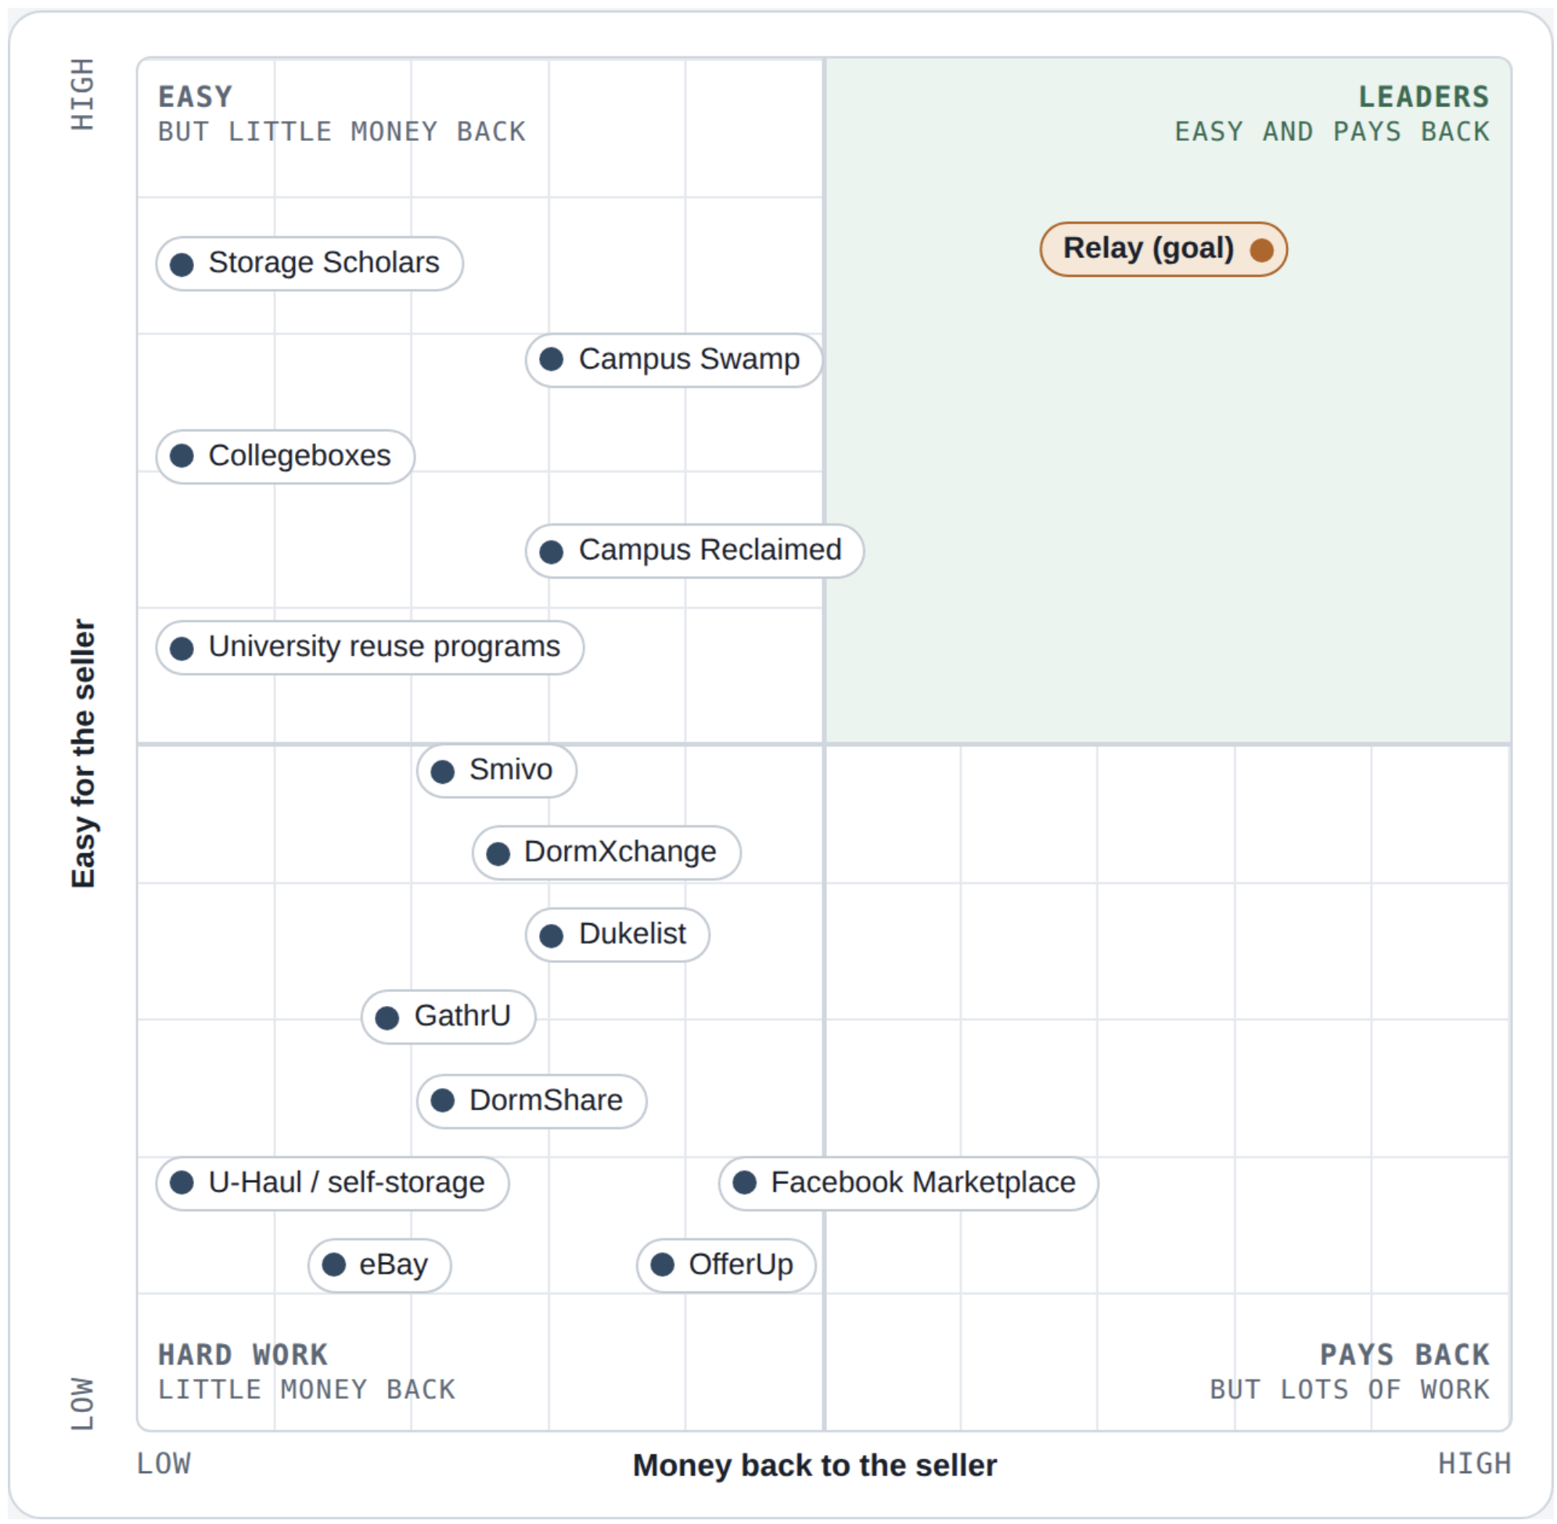
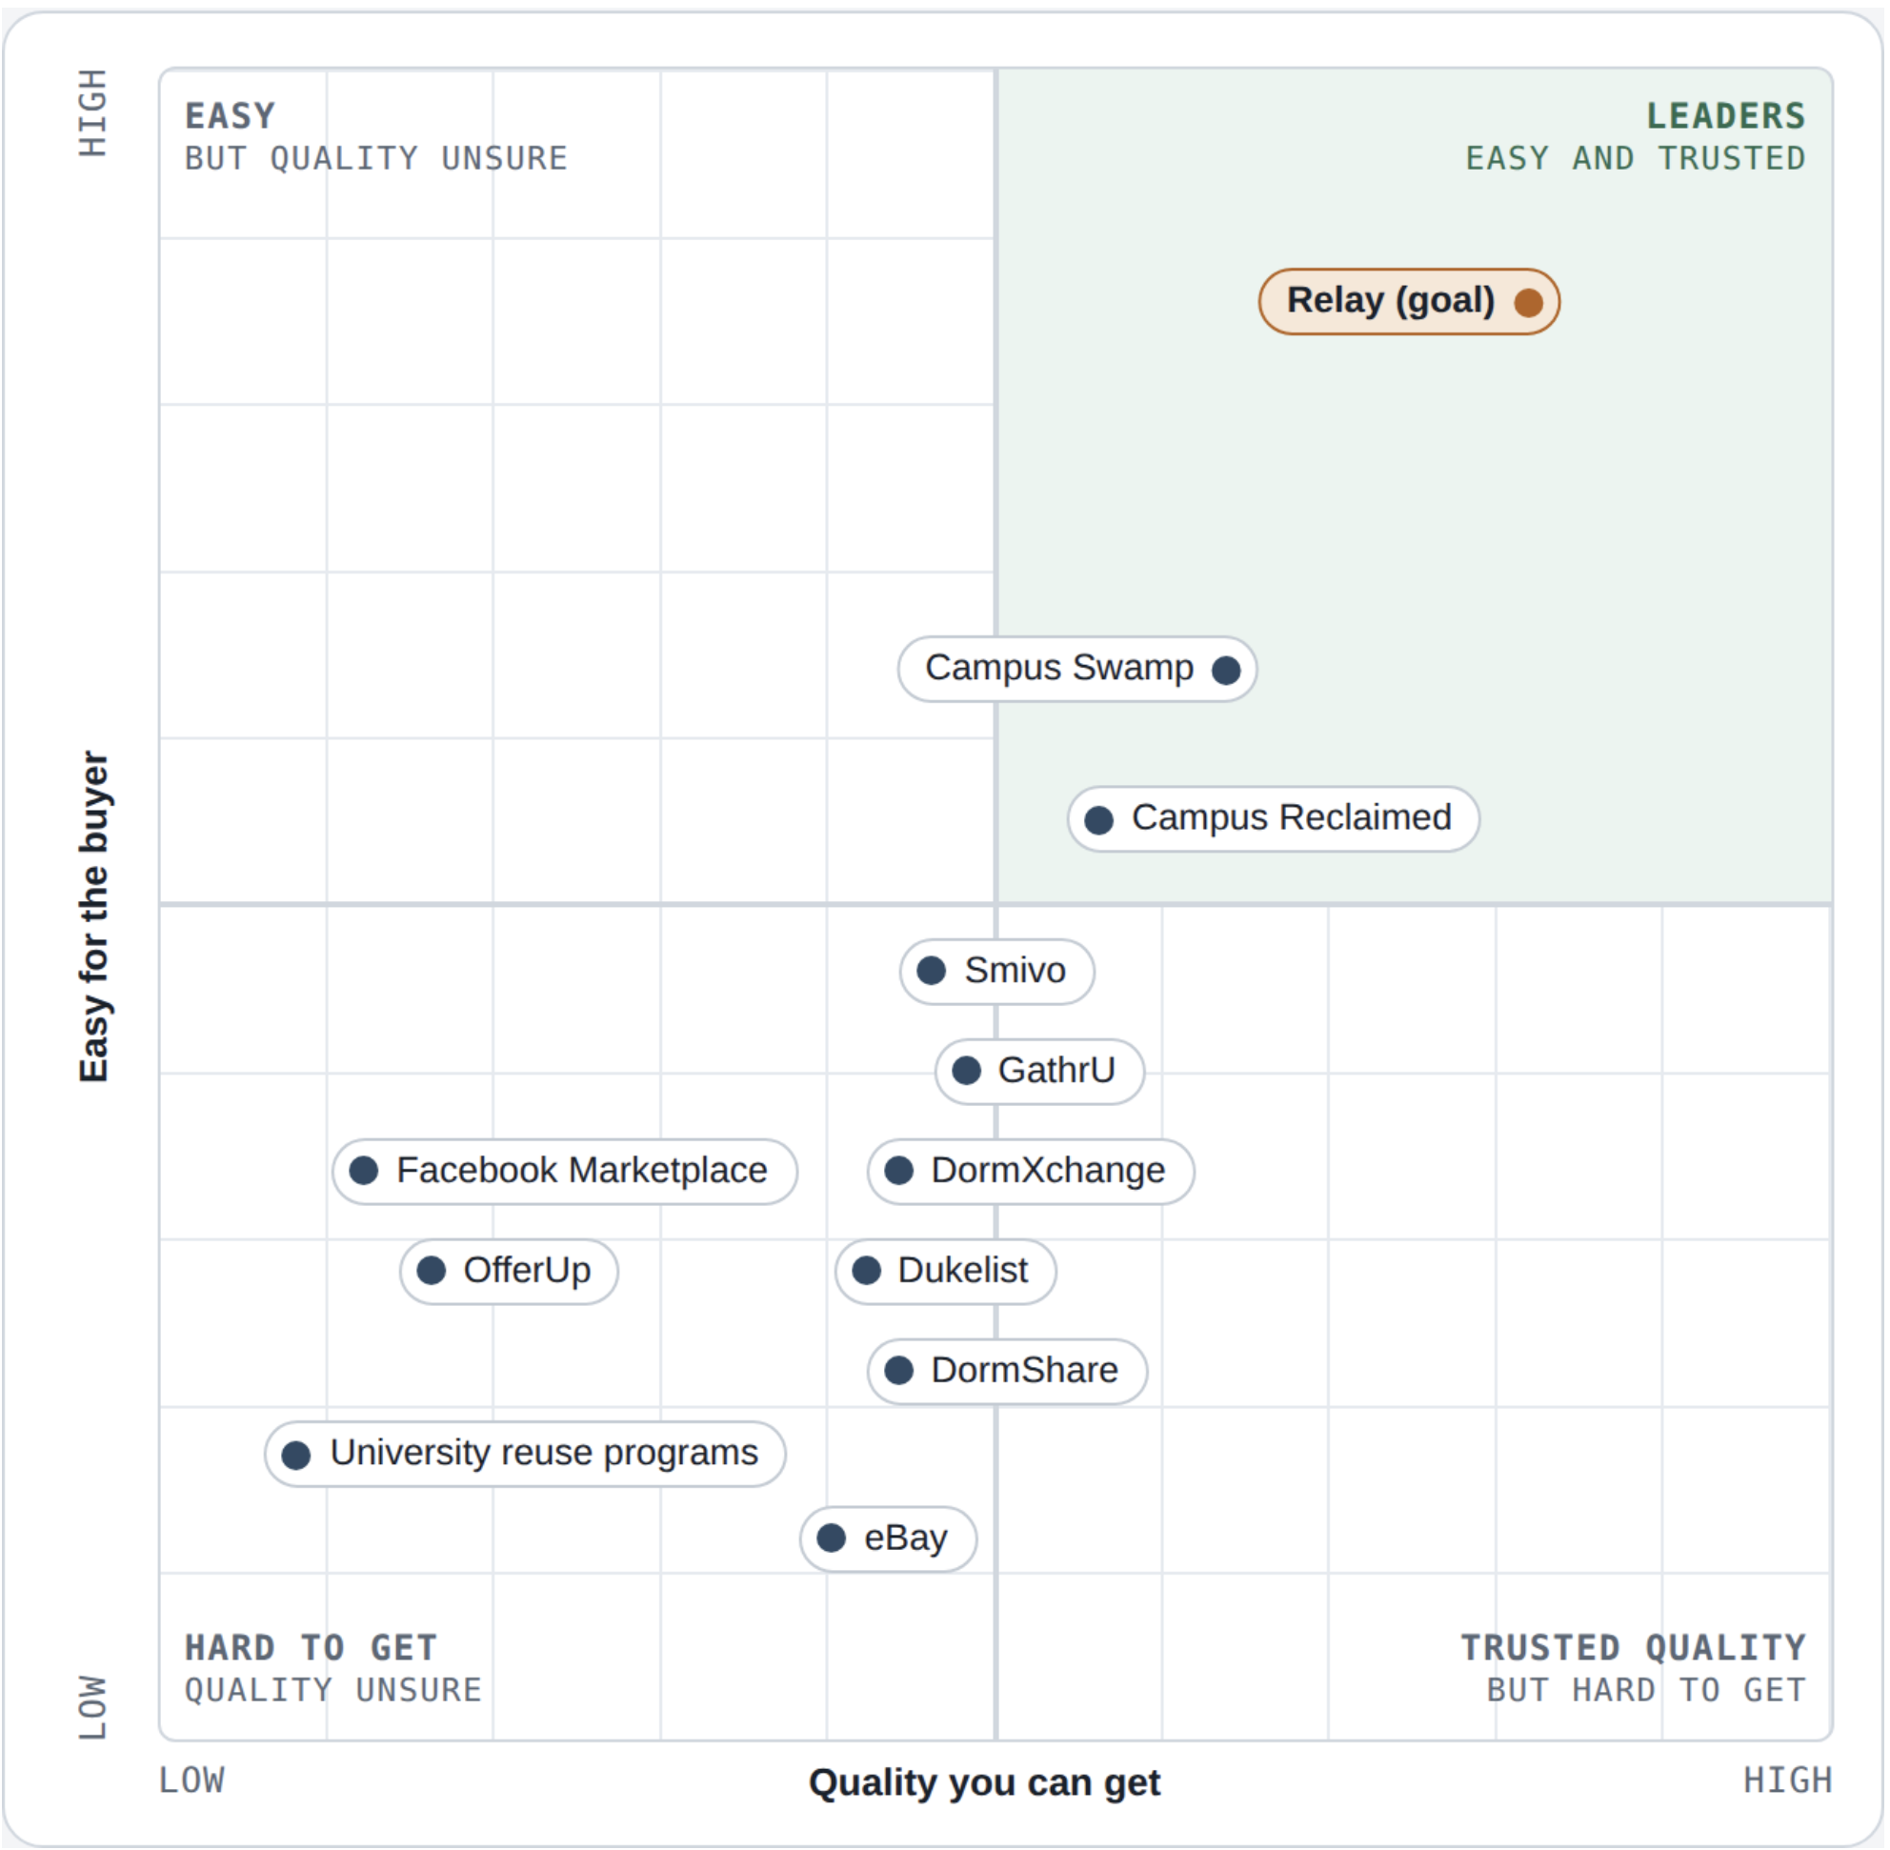
SLIDE 2 · LEADERS QUADRANT
No one bridges May to August for both sides
PLACEHOLDER · QUADRANT (SAMPLE DOTS, MOVE THEM)
Y-axis ↑ [label: e.g., low effort for seller]
Relay serves both sellers and buyers, so we mapped the market from each side.
The Seller Graph:
  X -> “Money Back To Seller”
  Y-> “Easy For Seller”
The Buyer Graph:
  X -> “Quality Buyer Can Get”
  Y -> “Easy For Buyer”
X-axis → [label: e.g., campus fit and timing]
Source: Workbook Part 3 (3C)
Relay · 04
Notes:
SHENWEI
SLIDE 2. Show your FINAL quadrant, not the AI's. State the axes and why they matter for the problem. Every competitor from both lists must appear. The commentary is the graded part: explain each placement you changed from the AI's version with evidence such as reviews, traction, funding, pricing or coverage. Dot positions and quadrant names here are only samples; place them from your own research. Do the 3A rough draft yourself before consulting the AI.

Slide 5
AI's read on the leader
DAFT
AI'S SWOT WITH CORRECTIONS
Strengths
Weaknesses
Solves the timing problem between move-out and the next school year
Students must pay storage fees even if they ultimately want to get rid of their furniture
Opportunities
Threats
Relay can partner with Storage Scholars’ storage facilities
Relay needs enough sellers and buyers at the same university
Source: Workbook Part 4 (4A)
Relay · 05
Notes:
kush
SLIDES 3 to 5 are fed by Part 4. This slide shows the AI's SWOT for its chosen leader (Storage Scholars) using the problem-solving lens: strengths and weaknesses are how well it solves the problem, opportunities are where the problem remains unsolved, and threats come from stronger problem-solvers. Do not paste the whole SWOT. Pick the sharpest points and visibly mark where you corrected the AI (for example, the AI claims Relay could partner with storage providers; is that realistic?). Evidence beats opinion.

Slide 6
Human Made SWOT
DRAFT
Storage Scholars VS. RELAY
Comparing Storage Scholars against Relay without AI
Strengths
Weaknesses
Furniture can be reused instead of wasted - buyer and seller both benefit
Needs enough buyers and sellers per campus to be profitable. Inventory is also limited when campus specific
Opportunities
Threats
Large marketplaces like those on Facebook are free, popular, and tech-friendly. Also direct campus specific competitors narrow the market space
Offer furniture to be delivered before arrival, so it is already there for the customer
Source: Workbook Part 4 (4B)
Relay · 06
Notes:
Kush
Your own SWOT, written without AI. Starter text is lifted from your 4B notes; tighten it and keep only the strongest points. Note that you argued Storage Scholars is a direct competitor for storage and delivery but not for resale, which is a real correction to the AI worth stating out loud. Add evidence (news, pricing pages, partnerships) wherever you can.

Slide 7
Where Relay wins and who goes first
PROBLEMS THEY MISS
EARLY ADOPTERS
UNIQUE VALUE
Take away the hassle of selling furniture on online marketplaces, and storing those things for future students.
ALso creating make independent contractor out of students who are willing to carry and move these products
Graduating students can sell their furniture to incoming students, so no furniture is wasted.
Graduating students that do not need the furniture anymore. As well as 1st year students with no furniture.
Source: Workbook Part 4 (4A + 4B)
Relay · 07
Notes:
kush
SLIDE 5. Turn the two SWOTs into direction. Because you have not locked a solution, be explicit about uncertainty: name two assumptions to test (for example, whether a state or local college has enough buyers and sellers, or whether damage and storage costs kill margin). Early adopters can be an unaddressed population, such as apartment complexes with post-remodel or abandoned furniture. Starter text comes from your pre-work notes.

Slide 8
SLIDE 6 · HARVEY BALLS
No one pays sellers well and covers the summer gap
Seller Value
Logistics & Timing
Buyer Value & Trust
Duke Market Fit
Competitor | Money back | Ease to sell | Low fees | Sure payout | Summer hold | Pickup | Delivery | Big items | August supply | Low price | Easy for buyer | Reserve early | Quality check | Verified students | Safety | At Duke | User base | Landfill
Relay (goal) | ◕ | ● | ◕ | ◕ | ● | ● | ● | ● | ● | ◕ | ● | ● | ● | ● | ◕ | ◕ | ○ | ●
Facebook Marketplace | ◔ | ◔ | ● | ◔ | ○ | ○ | ○ | ◔ | ◐ | ◕ | ◐ | ○ | ◔ | ○ | ◔ | ● | ● | ◐
OfferUp | ◔ | ◔ | ◕ | ◔ | ○ | ○ | ◔ | ◔ | ◔ | ◕ | ◔ | ○ | ◔ | ○ | ◐ | ◔ | ◕ | ◐
Craigslist | ◔ | ◔ | ● | ◔ | ○ | ○ | ○ | ◔ | ◔ | ◕ | ◔ | ○ | ○ | ○ | ○ | ◔ | ◐ | ◔
eBay | ◐ | ◐ | ◔ | ◕ | ○ | ○ | ◐ | ○ | ◐ | ◐ | ◔ | ◔ | ◐ | ○ | ● | ○ | ● | ◔
Dukelist | ◔ | ◔ | ● | ◔ | ○ | ○ | ○ | ◔ | ◔ | ◕ | ◔ | ◔ | ◔ | ◕ | ◔ | ● | ◐ | ◐
Small campus apps | ◔ | ◔ | ● | ◔ | ○ | ○ | ○ | ◔ | ◔ | ◕ | ◔ | ◔ | ◔ | ● | ◐ | ○ | ◔ | ◔
Group chats / Instagram | ◔ | ◐ | ● | ◔ | ○ | ○ | ○ | ◔ | ◔ | ◕ | ◔ | ◔ | ◐ | ◕ | ○ | ● | ◐ | ◔
Campus Swap | ◔ | ● | ◕ | ◐ | ● | ● | ◐ | ● | ● | ◕ | ◕ | ◕ | ◕ | ◐ | ◕ | ○ | ◔ | ●
Campus Reclaimed | ◔ | ◕ | ● | ◔ | ◕ | ◐ | ○ | ◔ | ◕ | ● | ◐ | ◐ | ◐ | ◔ | ◐ | ○ | ◔ | ◕
Storage Scholars | ○ | ○ | ○ | ○ | ● | ● | ● | ◕ | ○ | ○ | ○ | ◔ | ○ | ○ | ◕ | ● | ◕ | ◔
Collegeboxes (U-Haul) | ○ | ○ | ○ | ○ | ● | ◕ | ● | ◔ | ○ | ○ | ○ | ◔ | ○ | ○ | ◕ | ◔ | ◕ | ◔
Self-storage units | ○ | ○ | ○ | ○ | ● | ○ | ○ | ● | ○ | ○ | ○ | ○ | ○ | ○ | ◐ | ◕ | ● | ◔
Duke donation programs | ○ | ● | ● | ○ | ○ | ◔ | ○ | ◐ | ◔ | ● | ◔ | ○ | ◔ | ◕ | ◔ | ● | ◐ | ●
Buying new | ○ | ○ | ○ | ○ | ○ | ○ | ● | ● | ● | ◔ | ● | ● | ● | ○ | ● | ● | ● | ○
Key: ● strong · ◕ moderate-high · ◐ moderate-low · ◔ low · ○ none Orange header = criteria we added Orange cell = score we changed from the AI
WHAT WE CHANGED. Added low fees for sellers (storage costs $300–$500 a summer) and easy for buyer (a buyer-quadrant axis). Removed multi-campus reach (we start at Duke).
Money back ◐→◔ for local marketplaces: May prices crash (a $100 table sells for ~$20). Ease to sell ◔→○ for Storage Scholars / Collegeboxes: they don't sell. At Duke lowered for Collegeboxes and campus apps: no current Duke presence found.
Big items ◐→◔ for Campus Reclaimed: its top furniture price is $99. Summer hold ◔→○ for Duke donations: items go to TROSA and Goodwill, not new students.
Source: Workbook Part 5 (5C)
Relay · 08
Notes:
MIHIR
Final Harvey Ball matrix (workbook 5C). 18 criteria in 4 categories, 15 rows. Orange headers are criteria we added (low seller cost, easy for buyer); orange cells are scores we changed from the AI. Main point: Campus Swap covers logistics but pays sellers little and isn't at Duke; Storage Scholars is at Duke but doesn't sell. Nobody combines good seller payout with the summer hold. Relay row shows our goals, not facts. Small campus apps = DormXchange, DormShare, Smivo, GathrU.

Slide 9
SLIDE 7 · HARVEY BALL SUMMARY
No one does it all, and Campus Swap is closest
01
02
03
Key Discoveries
Prioritize / Ignore
Rivals to Watch
No one does it all. Some sell but don't store; others store but don't sell.
Campus Swap is closest, but it's at UNC and sellers start at 20%.
Selling in May pays badly: buyers don't arrive until August.
For buyers, our real rival is buying new.
Focus on: money back, ease to sell, summer hold, low buyer price, being at Duke.
Ignore for now: multi-campus reach and user base. We start at Duke and are new.
Less important rivals: Craigslist, OfferUp, eBay, small campus apps, self-storage, Campus Reclaimed.
Campus Swap: same idea, about 10 miles away.
Storage Scholars: already at Duke. Could add resale, or be a partner.
Facebook Marketplace: free, and everyone uses it.
Duke donation bins: free and zero effort.
Source: Workbook Part 5 (5D)
Relay · 09
Notes:
MIHIR
Harvey Ball summary (workbook 5D). Key point: the market splits into sellers-without-storage and storage-without-selling. Campus Swap is the closest model but is at UNC and pays sellers 20% to start. Biggest threats: Campus Swap, Storage Scholars, Facebook Marketplace, Duke donation bins.

Slide 10
NARRATIVE · NO AI
WRITE IT YOURSELF
What I learned
01
02
03
What I found on my own
Where I corrected the AI
Strategic insights
There are indeed some websites aimed at tackling this problem within universities, but they don’t have a large selection of tools
AI sometimes did too much segmentation for the Harvey Balls table and other things that were not as helpful as it might have been intending.
AI missed how regionality can really influence the market of this type of product.
Public Storage is also an alternative solution to this problem.
Could offer students contracted positions to actually pick up furniture
Source: Workbook Part 6 (6A + 6C)
Relay · 10
Notes:
Sam
NARRATIVE (no AI). This is the core of your grade. Tell the story: what you discovered independently, where and why you corrected the AI, 2 to 3 strategic insights from combining your view with the AI's, what the AI missed, and the gaps and opportunities you found. You can add a line from your 6C reflection on where you agreed or disagreed with the AI and what assumptions became clearer.

Slide 11
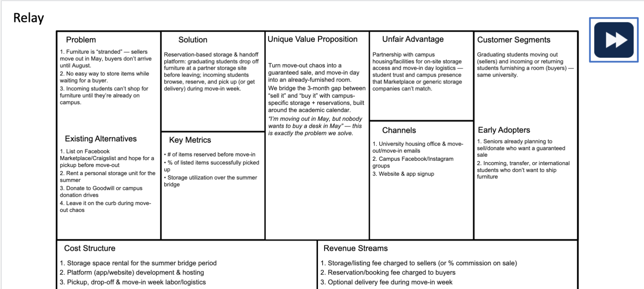
Old Lean Canvas

Slide 12
Original Lean Canvas
LEAN CANVAS · NO AI
Lean canvas, Changes
Orange outline = update these from your competitive analysis: problem, value proposition, channels, and advantage.
Problem
Solution
Value prop
Advantage
Customers
Seniors must get rid of furniture before incoming students arrive.
Existing resale options do not solve storage or delayed handoff.
Campus resale marketplace with integrated summer storage and move-in delivery.
University partnerships → More sellers create better inventory, attracting more buyers and strengthening local marketplace liquidity.
Sellers: graduating or moving-out students
Buyers: incoming, students
Early adopters: students with limited storage, transportation, or local support
Buy and sell campus furniture across the summer gap without storing, shipping, or coordinating handoffs yourself.
Alternatives
Key metrics
Channels
Costs
Revenue
Facebook Marketplace / Craigslist
Self-storage + later resale
Donation or campus drives
Sell-through rate
% inventory reserved before move-in
Contribution margin per item
University housing and move-out emails
International / transfer orientation
Residence halls and apartment complexes
Storage, pickup, damage
Transaction commission / service fee
Optional delivery fee
Optional storage or premium handling fee
Source: Workbook Part 6 (6B)
Relay · 11
Notes:
SAM + MIHIR
LEAN CANVAS (no AI). Paste or rebuild your existing Lean Canvas here and update it from what the competitive analysis taught you. The four orange-outlined boxes are the ones the assignment asks about: customer problems, unique value proposition, channels and differentiation, and competitive advantage. If you attach the canvas separately, replace this slide with a picture of it or a note pointing to the file.

